Slide 1





Slide 2
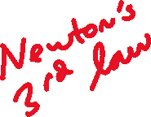

Slide 3
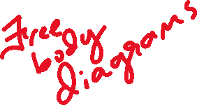

Slide 4



Slide 5
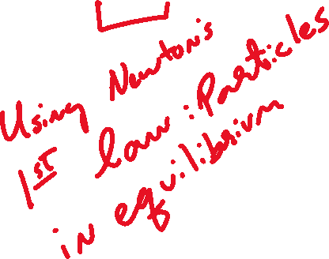

Slide 6








Slide 7



Slide 8

A force acting on an object is always the result of its interaction with another object,

Slide 9
A force acting on an object is always the result of its interaction with another object, so forces always come in pairs.

Slide 10
A force acting on an object is always the result of its interaction with another object, so forces always come in pairs. You can’t pull on a doorknob without the doorknob pulling back on you.

Slide 11
A force acting on an object is always the result of its interaction with another object, so forces always come in pairs. You can’t pull on a doorknob without the doorknob pulling back on you. When you kick a football, your foot exerts a forward force on the ball,

Slide 12
A force acting on an object is always the result of its interaction with another object, so forces always come in pairs. You can’t pull on a doorknob without the doorknob pulling back on you. When you kick a football, your foot exerts a forward force on the ball, but you also feel the force the ball exerts back on your foot.

Slide 13
A force acting on an object is always the result of its interaction with another object, so forces always come in pairs. You can’t pull on a doorknob without the doorknob pulling back on you. When you kick a football, your foot exerts a forward force on the ball, but you also feel the force the ball exerts back on your foot.
In each of these cases,

Slide 14
A force acting on an object is always the result of its interaction with another object, so forces always come in pairs. You can’t pull on a doorknob without the doorknob pulling back on you. When you kick a football, your foot exerts a forward force on the ball, but you also feel the force the ball exerts back on your foot.
In each of these cases, the force that you exert on the other object is in the opposite direction to the force that object exerts on you.

Slide 15
A force acting on an object is always the result of its interaction with another object, so forces always come in pairs. You can’t pull on a doorknob without the doorknob pulling back on you. When you kick a football, your foot exerts a forward force on the ball, but you also feel the force the ball exerts back on your foot.
In each of these cases, the force that you exert on the other object is in the opposite direction to the force that object exerts on you. Experiments show that whenever two objects interact,

Slide 16
A force acting on an object is always the result of its interaction with another object, so forces always come in pairs. You can’t pull on a doorknob without the doorknob pulling back on you. When you kick a football, your foot exerts a forward force on the ball, but you also feel the force the ball exerts back on your foot.
In each of these cases, the force that you exert on the other object is in the opposite direction to the force that object exerts on you. Experiments show that whenever two objects interact, the two forces that they exert on each other are always

Slide 17
A force acting on an object is always the result of its interaction with another object, so forces always come in pairs. You can’t pull on a doorknob without the doorknob pulling back on you. When you kick a football, your foot exerts a forward force on the ball, but you also feel the force the ball exerts back on your foot.
In each of these cases, the force that you exert on the other object is in the opposite direction to the force that object exerts on you. Experiments show that whenever two objects interact, the two forces that they exert on each other are always equal in magnitude and

Slide 18
A force acting on an object is always the result of its interaction with another object, so forces always come in pairs. You can’t pull on a doorknob without the doorknob pulling back on you. When you kick a football, your foot exerts a forward force on the ball, but you also feel the force the ball exerts back on your foot.
In each of these cases, the force that you exert on the other object is in the opposite direction to the force that object exerts on you. Experiments show that whenever two objects interact, the two forces that they exert on each other are always equal in magnitude and opposite in direction.

Slide 19
A force acting on an object is always the result of its interaction with another object, so forces always come in pairs. You can’t pull on a doorknob without the doorknob pulling back on you. When you kick a football, your foot exerts a forward force on the ball, but you also feel the force the ball exerts back on your foot.
In each of these cases, the force that you exert on the other object is in the opposite direction to the force that object exerts on you. Experiments show that whenever two objects interact, the two forces that they exert on each other are always equal in magnitude and opposite in direction. This fact is called Newton’s third law of motion

Slide 20

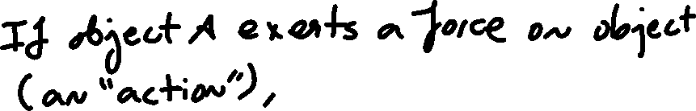

Slide 21
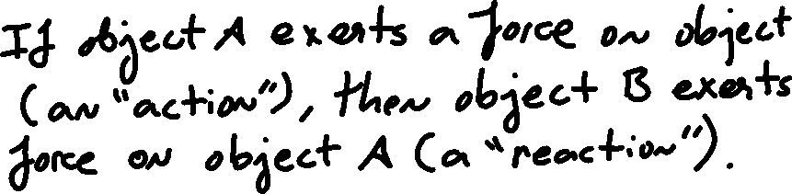

Slide 22






Slide 23




Slide 24







Slide 25
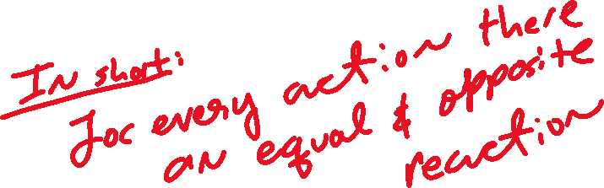

Slide 26


Slide 27


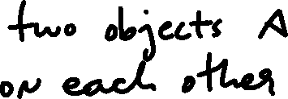



Slide 28



Slide 29
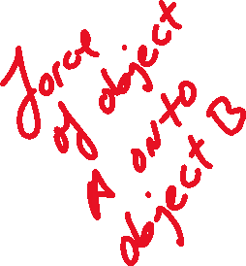


Slide 30






Slide 31





Slide 32
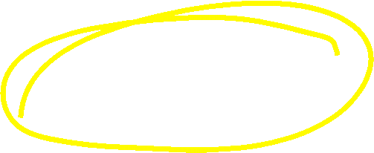

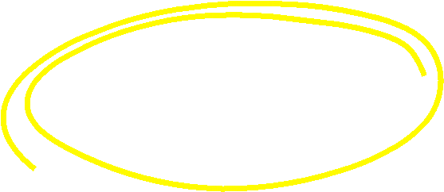


Slide 33
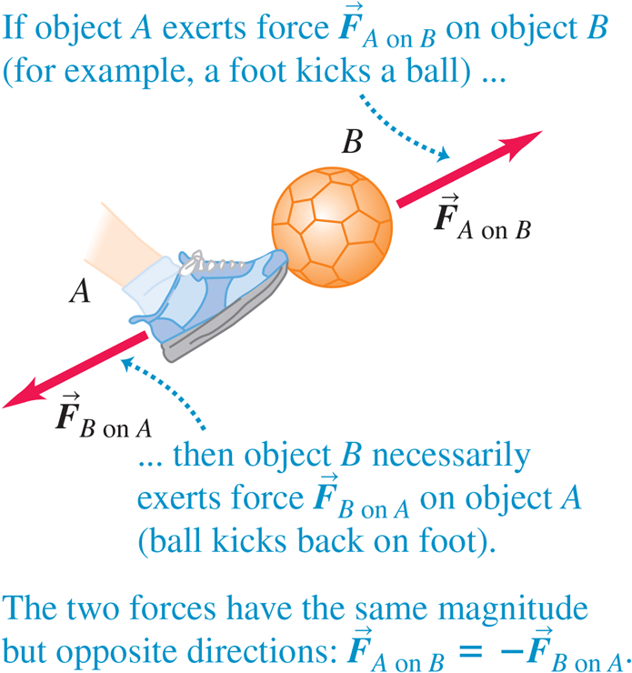



Slide 34




Slide 35


Slide 36



Slide 38


Slide 41





Slide 42



Slide 43



Slide 44
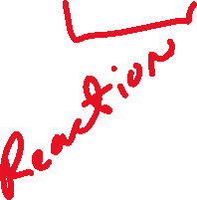

Slide 45
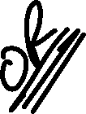

Slide 46
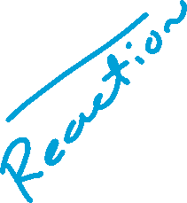


Slide 47

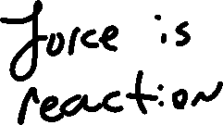






Slide 48




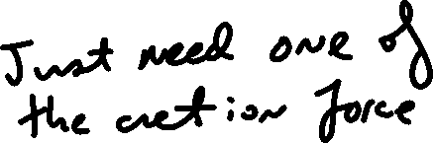





Slide 49



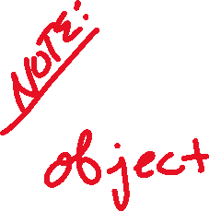

Slide 50








Slide 51
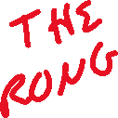










Slide 52
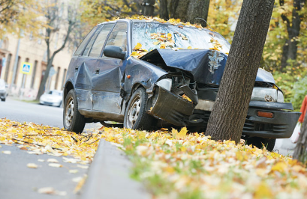
Blame Newton’s Laws

Slide 53
Blame Newton’s Laws
This car stopped because of Newton’s second and third laws.

Slide 54
Blame Newton’s Laws
This car stopped because of Newton’s second and third laws. During the impact, the car exerted a force on the tree;

Slide 55
Blame Newton’s Laws
This car stopped because of Newton’s second and third laws. During the impact, the car exerted a force on the tree; in accordance with the third law, the tree exerted an equally strong force back on the car.

Slide 56
Blame Newton’s Laws
This car stopped because of Newton’s second and third laws. During the impact, the car exerted a force on the tree; in accordance with the third law, the tree exerted an equally strong force back on the car. In accordance with the second law,

Slide 57
Blame Newton’s Laws
This car stopped because of Newton’s second and third laws. During the impact, the car exerted a force on the tree; in accordance with the third law, the tree exerted an equally strong force back on the car. In accordance with the second law, the force of the tree on the car gave the car an acceleration that changed its velocity to zero

Slide 58


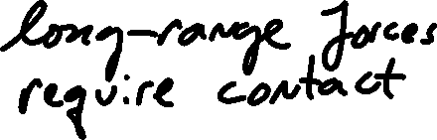







Slide 59



Slide 60



Slide 61



Slide 62


Slide 63









Slide 64





Slide 65


Slide 66
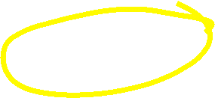
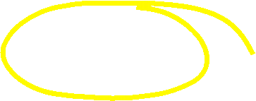

Slide 68
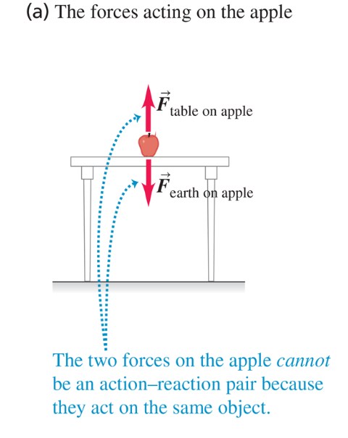

Slide 69
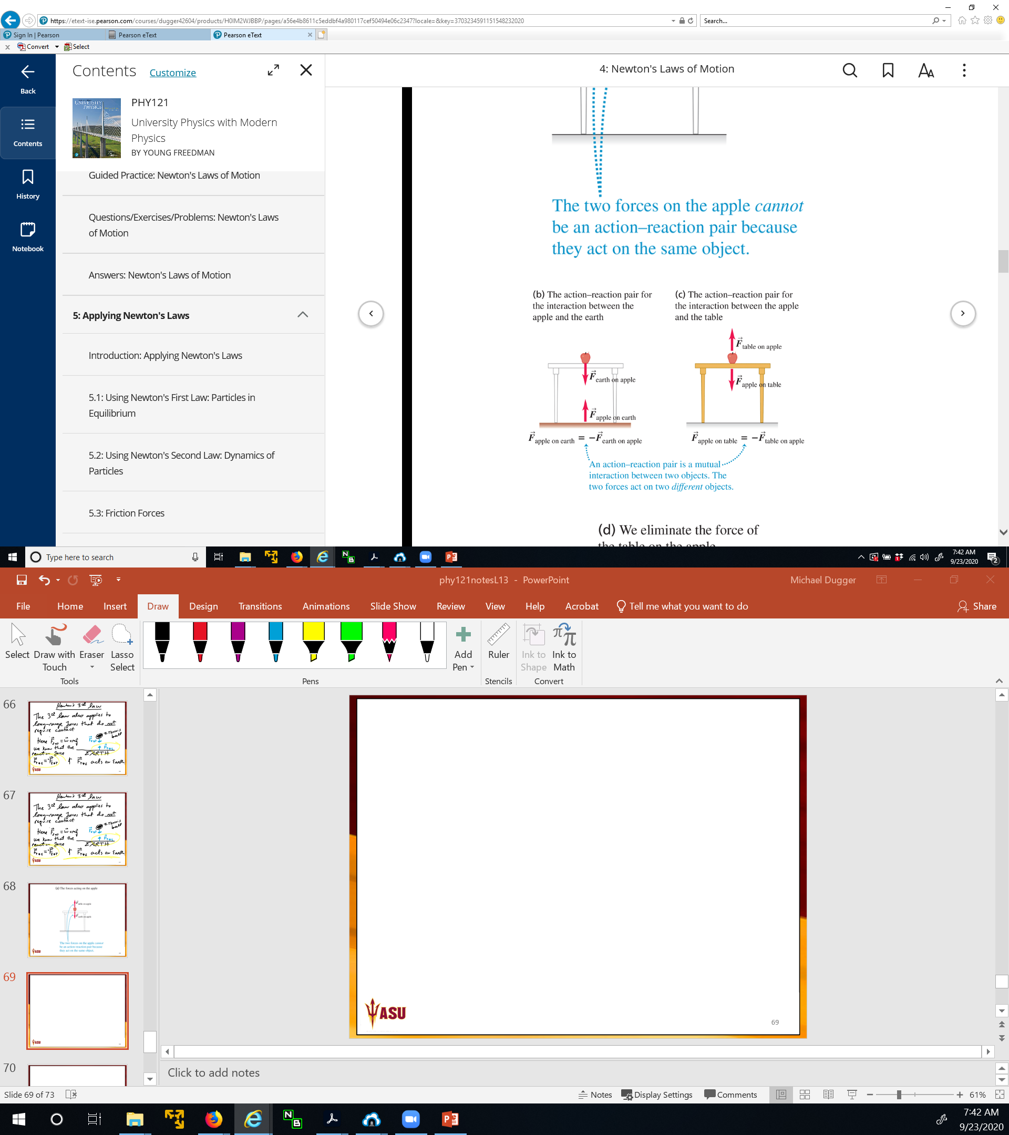


Slide 70


Slide 71



Slide 73
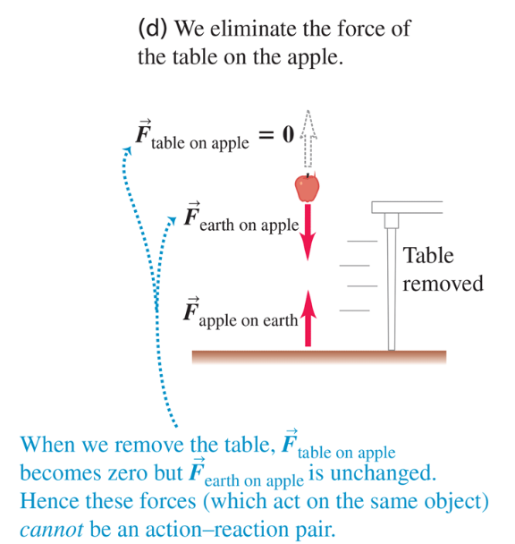

Slide 74
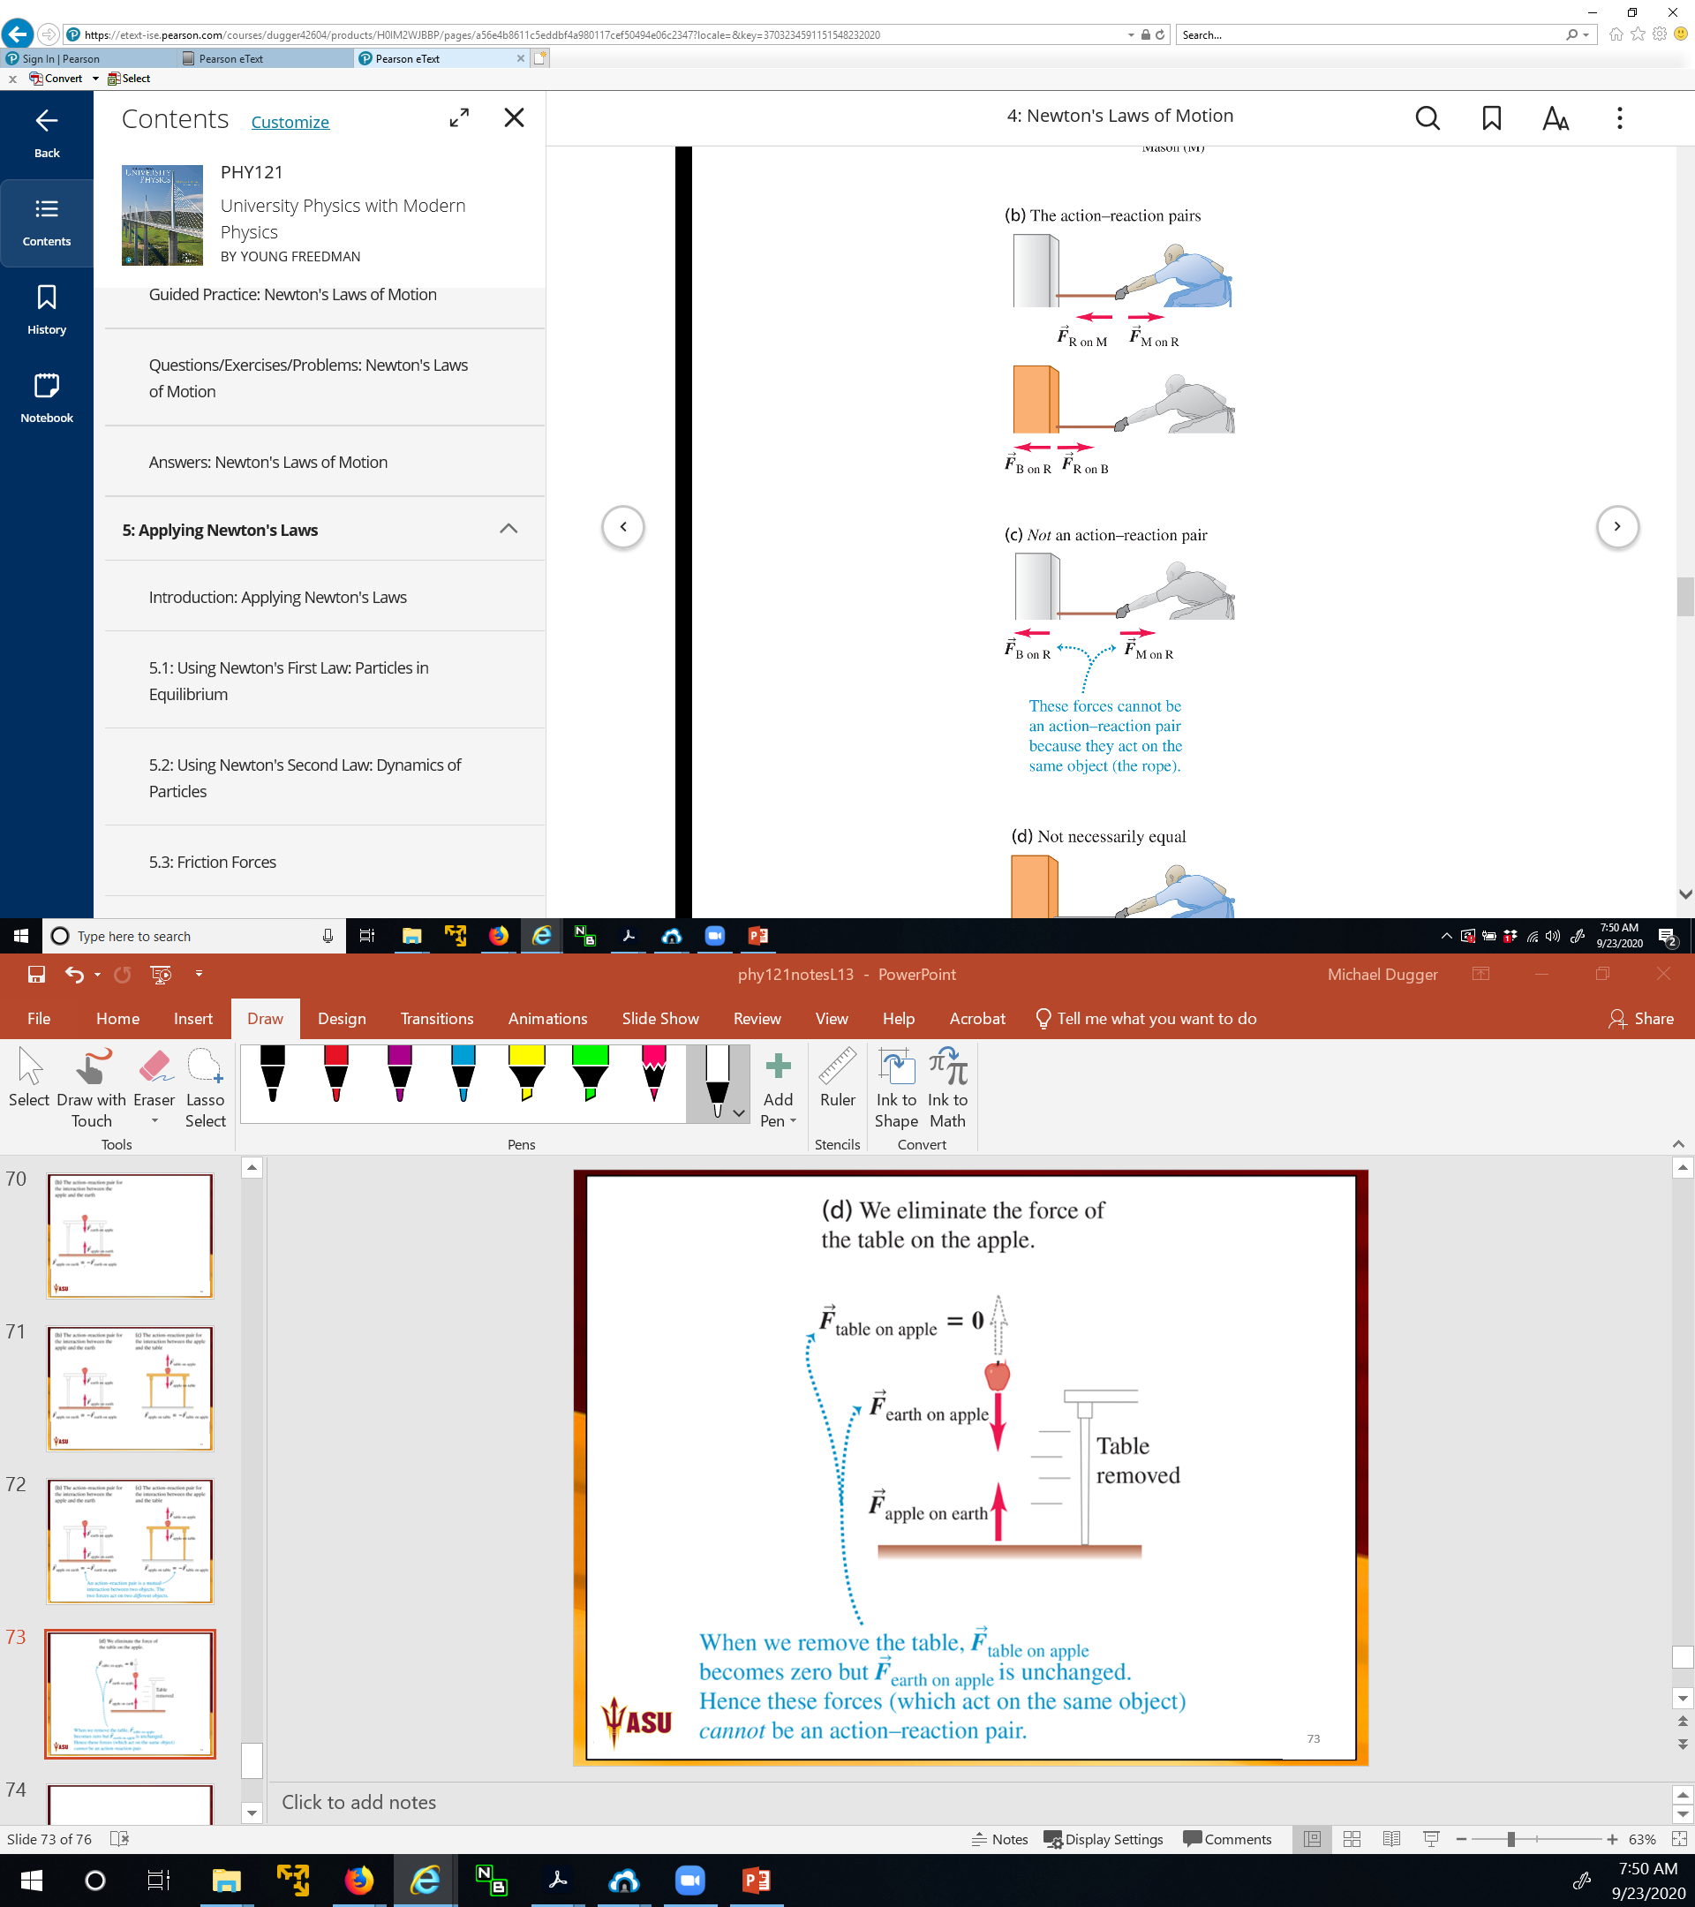

Slide 75






Slide 76

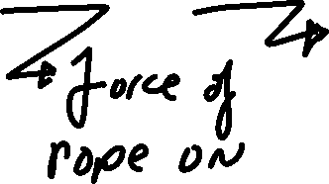

Slide 78




Slide 79


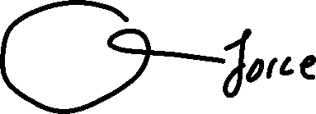



Slide 81
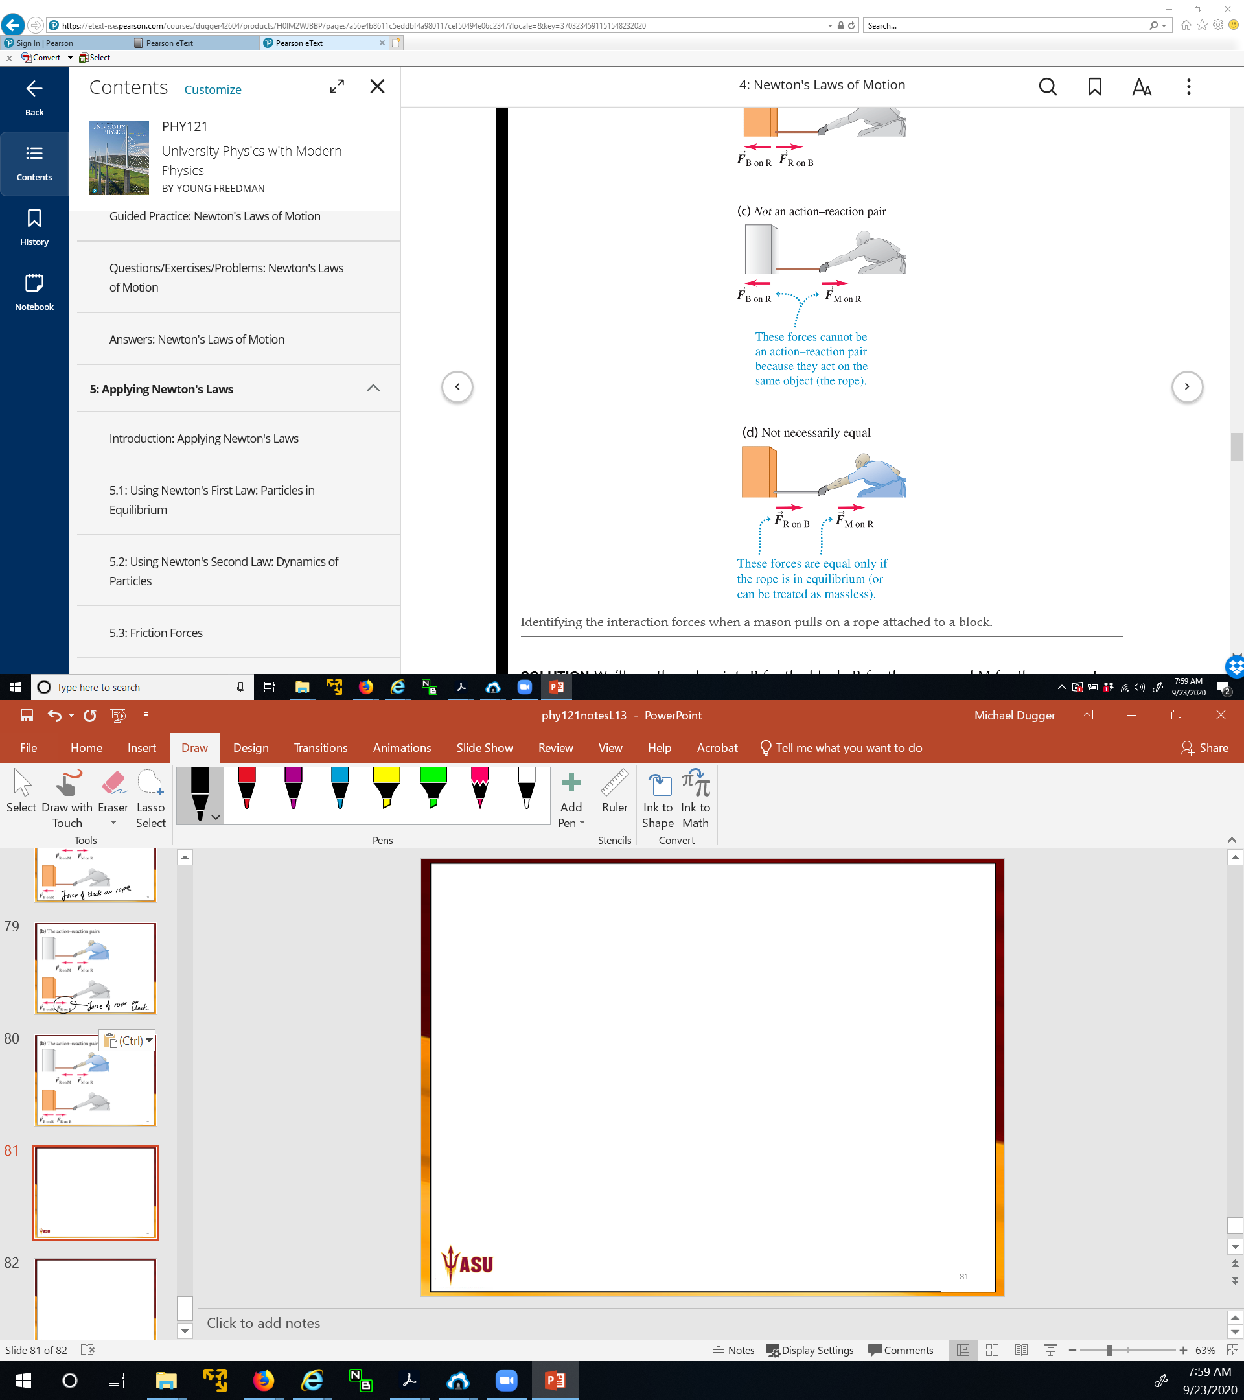


Slide 84





Slide 85

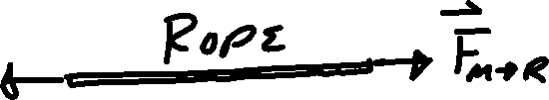

Slide 86



Slide 87





Slide 88





Slide 89
The stonemason pulls as hard on the rope–block combination as that combination pulls back on him. Why, then, does the block move while the stonemason remains stationary?

Slide 90
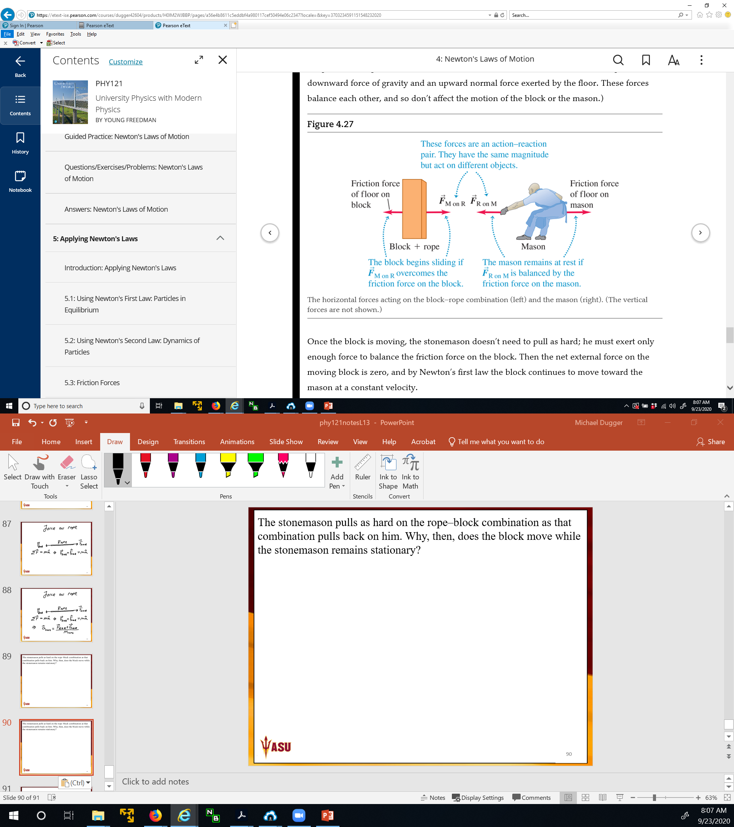



The stonemason pulls as hard on the rope–block combination as that combination pulls back on him. Why, then, does the block move while the stonemason remains stationary?

Slide 91

The stonemason pulls as hard on the rope–block combination as that combination pulls back on him. Why, then, does the block move while the stonemason remains stationary?

Slide 92


The stonemason pulls as hard on the rope–block combination as that combination pulls back on him. Why, then, does the block move while the stonemason remains stationary?

Slide 93

The stonemason pulls as hard on the rope–block combination as that combination pulls back on him. Why, then, does the block move while the stonemason remains stationary?

Slide 94
The stonemason pulls as hard on the rope–block combination as that combination pulls back on him. Why, then, does the block move while the stonemason remains stationary?

Slide 95
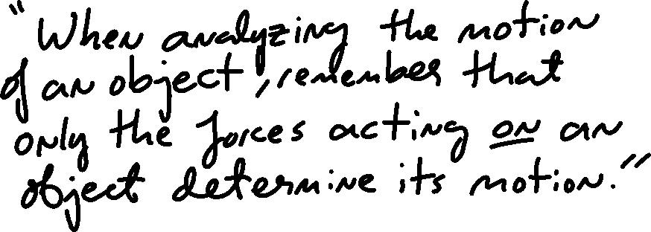

Slide 96

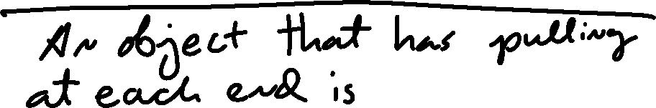


Slide 97




Slide 98
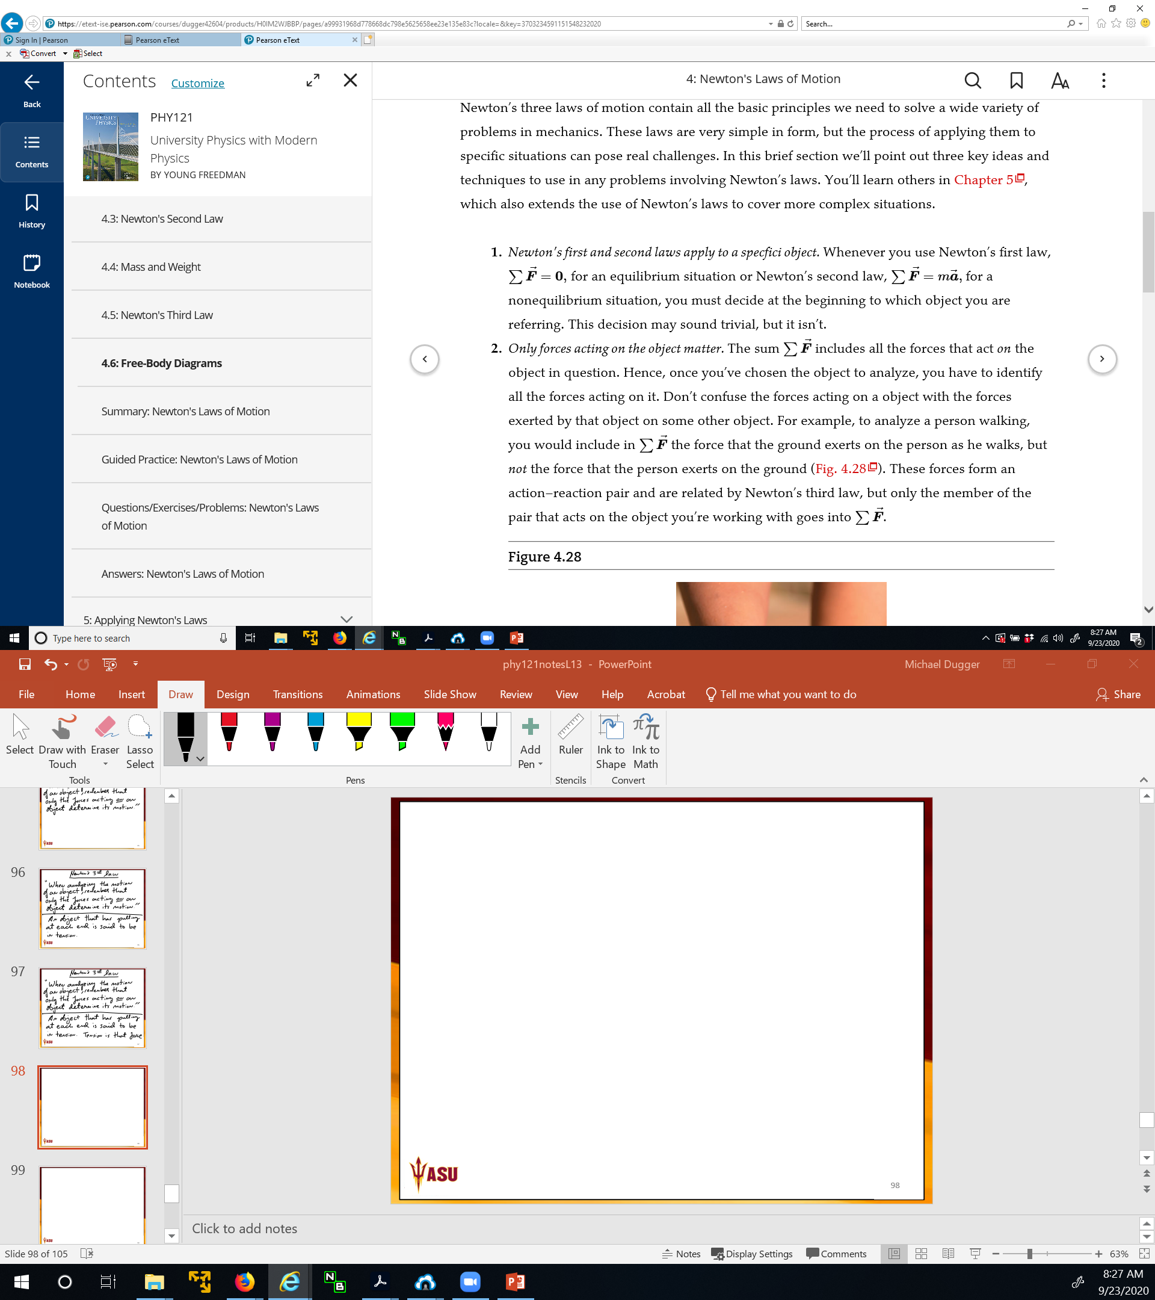


Slide 99


Slide 100


Slide 101


Slide 103


Slide 104


Slide 105


Slide 106


Slide 107
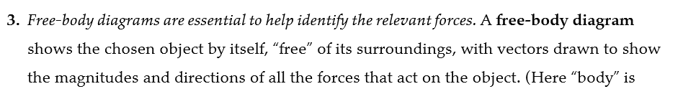


Slide 108


Slide 109


Slide 110
