Slide 1






Slide 2


Slide 3


Slide 4




Slide 5



Slide 6



Slide 7









Slide 8





Slide 10
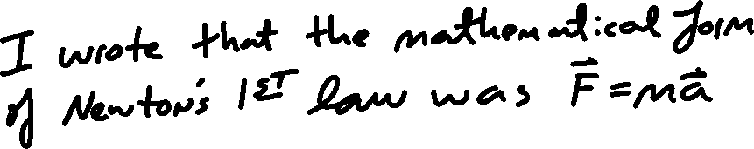

Slide 11
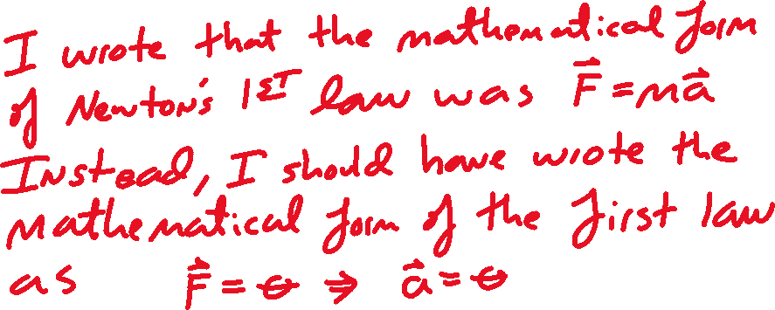


Slide 12




Slide 13










Slide 14
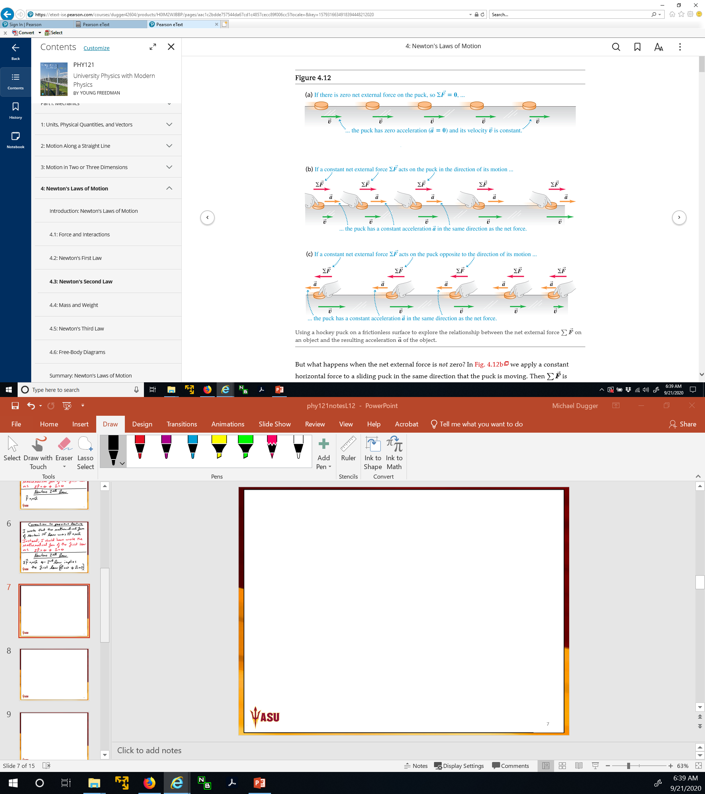

Slide 17
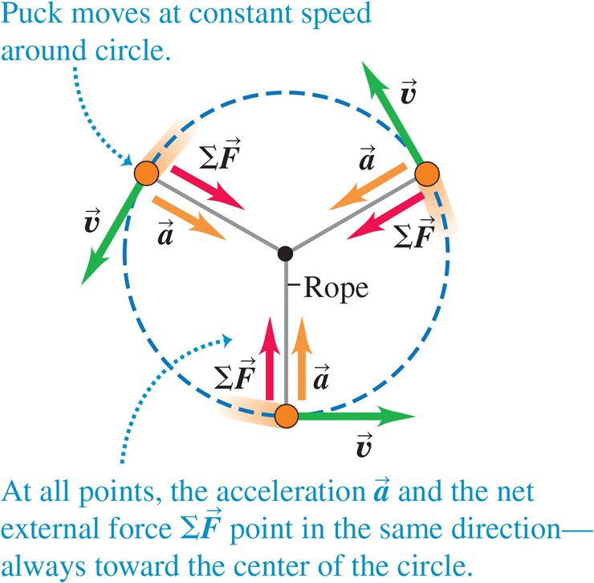

Slide 18


Slide 21


Slide 22



Slide 23




Slide 24





Slide 25





Slide 26


Slide 27





Slide 28



Slide 29






Slide 30


Slide 31


Slide 33


Slide 35



Slide 37


Slide 38




Slide 39



Slide 40



Slide 41





Slide 42



Slide 43




Slide 44

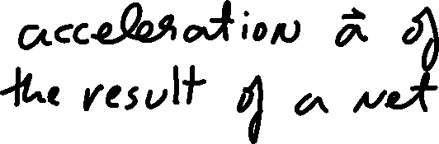




Slide 45


Slide 46
A worker applies a constant horizontal force with magnitude 20 N to a box with mass 40 kg resting on a level, freshly waxed floor with negligible friction. What is the acceleration of the box?

Slide 47




A worker applies a constant horizontal force with magnitude 20 N to a box with mass 40 kg resting on a level, freshly waxed floor with negligible friction. What is the acceleration of the box?

Slide 48

A worker applies a constant horizontal force with magnitude 20 N to a box with mass 40 kg resting on a level, freshly waxed floor with negligible friction. What is the acceleration of the box?

Slide 49


A worker applies a constant horizontal force with magnitude 20 N to a box with mass 40 kg resting on a level, freshly waxed floor with negligible friction. What is the acceleration of the box?

Slide 50

A worker applies a constant horizontal force with magnitude 20 N to a box with mass 40 kg resting on a level, freshly waxed floor with negligible friction. What is the acceleration of the box?

Slide 51




A worker applies a constant horizontal force with magnitude 20 N to a box with mass 40 kg resting on a level, freshly waxed floor with negligible friction. What is the acceleration of the box?

Slide 52
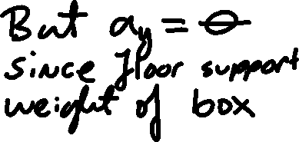
A worker applies a constant horizontal force with magnitude 20 N to a box with mass 40 kg resting on a level, freshly waxed floor with negligible friction. What is the acceleration of the box?

Slide 53



A worker applies a constant horizontal force with magnitude 20 N to a box with mass 40 kg resting on a level, freshly waxed floor with negligible friction. What is the acceleration of the box?

Slide 54



A worker applies a constant horizontal force with magnitude 20 N to a box with mass 40 kg resting on a level, freshly waxed floor with negligible friction. What is the acceleration of the box?

Slide 55




A worker applies a constant horizontal force with magnitude 20 N to a box with mass 40 kg resting on a level, freshly waxed floor with negligible friction. What is the acceleration of the box?

Slide 56


A worker applies a constant horizontal force with magnitude 20 N to a box with mass 40 kg resting on a level, freshly waxed floor with negligible friction. What is the acceleration of the box?

Slide 57



A worker applies a constant horizontal force with magnitude 20 N to a box with mass 40 kg resting on a level, freshly waxed floor with negligible friction. What is the acceleration of the box?

Slide 58


A worker applies a constant horizontal force with magnitude 20 N to a box with mass 40 kg resting on a level, freshly waxed floor with negligible friction. What is the acceleration of the box?

Slide 59

A worker applies a constant horizontal force with magnitude 20 N to a box with mass 40 kg resting on a level, freshly waxed floor with negligible friction. What is the acceleration of the box?

Slide 60

A worker applies a constant horizontal force with magnitude 20 N to a box with mass 40 kg resting on a level, freshly waxed floor with negligible friction. What is the acceleration of the box?

Slide 61
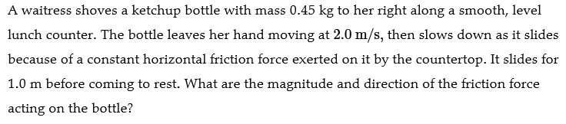

Slide 62



Slide 63



Slide 65

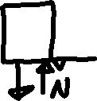


Slide 66


Slide 67



Slide 68


Slide 69



Slide 70



Slide 71



Slide 72




Slide 73



Slide 74



Slide 75
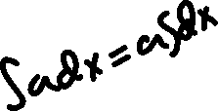


Slide 76


Slide 77





Slide 78



Slide 79




Slide 80





Slide 81


Slide 82


Slide 84


Slide 85






Slide 86







Slide 87



Slide 88





Slide 89




Slide 90






Slide 91



Slide 92


Slide 93




Slide 94



Slide 95


Slide 96



Slide 97




Slide 98






Slide 99




Slide 100



Slide 101



Slide 102


Slide 103





Slide 104



Slide 105





