Slide 1




Slide 2


Slide 3



Slide 4




Slide 5
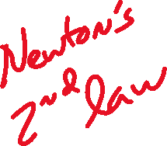


Slide 6



Slide 7


Slide 8
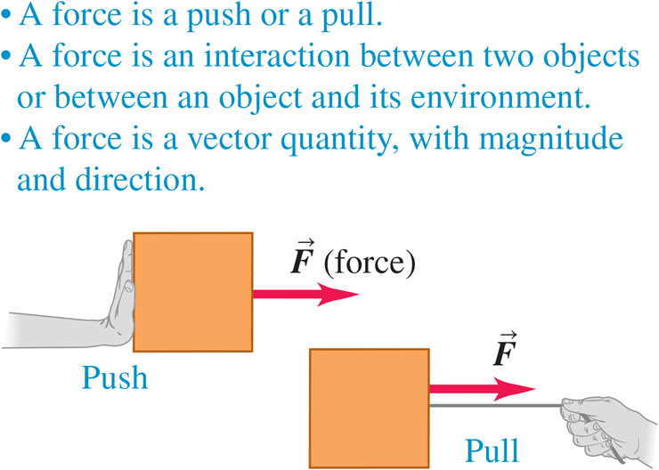

Slide 9


Slide 14



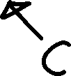

Slide 15


Slide 16


Slide 17


Slide 19





Slide 20





Slide 21





Slide 22



Slide 23




Slide 24


Slide 25


Slide 26
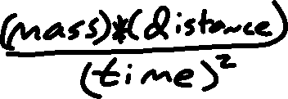

Slide 27
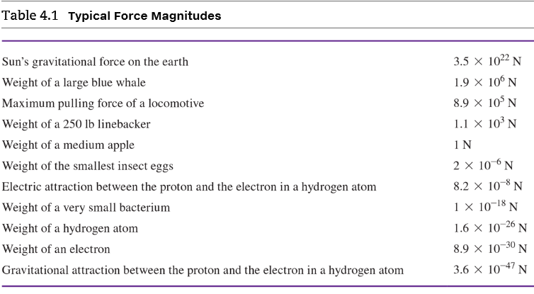

Slide 29





Slide 30


Slide 31



Slide 32
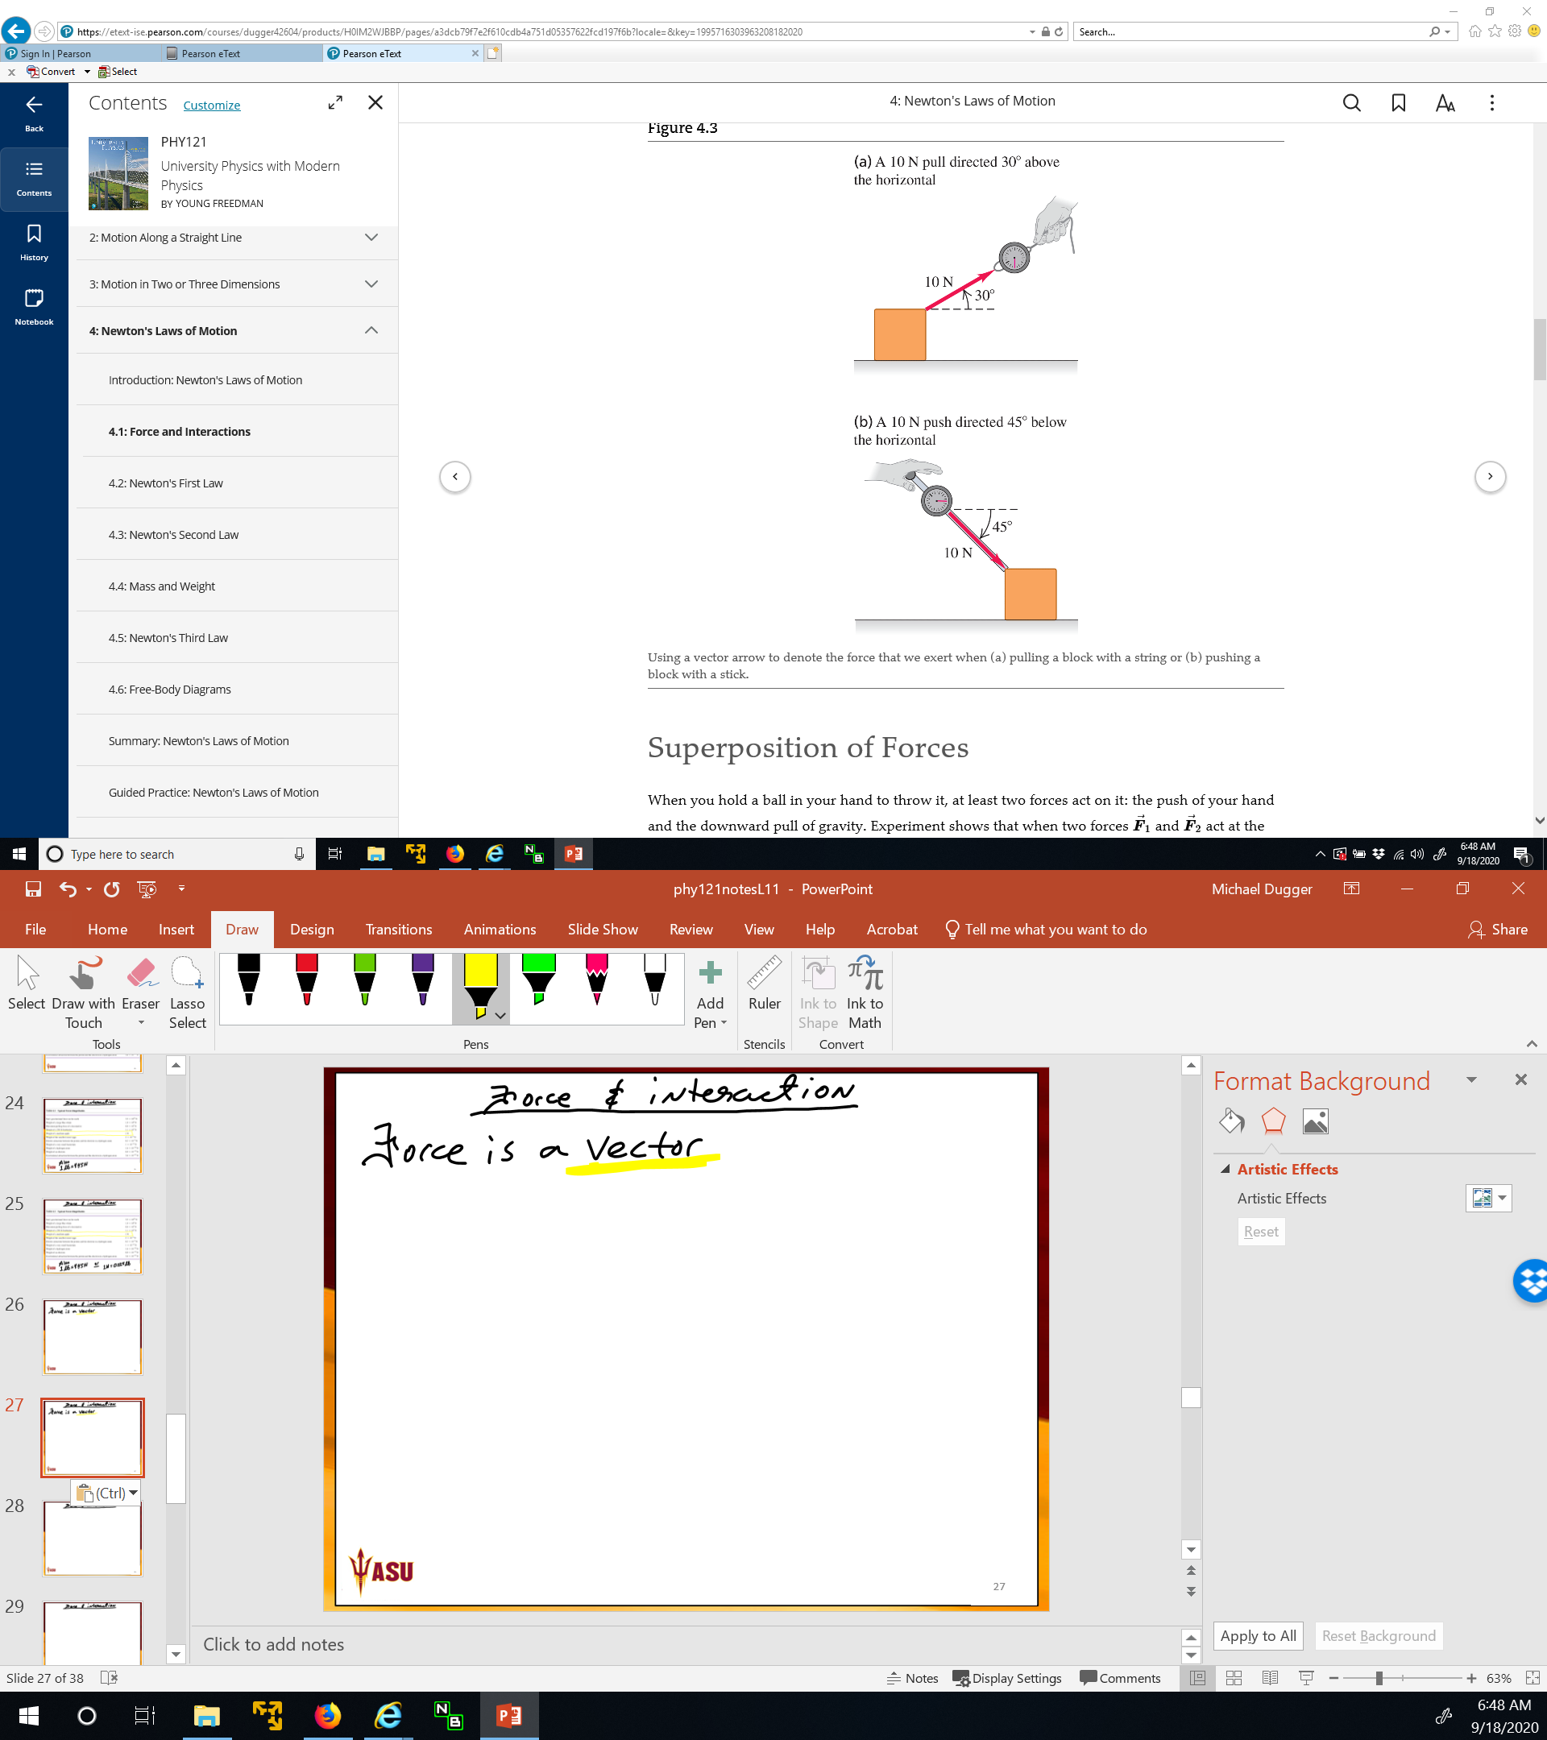

Slide 33


Slide 34
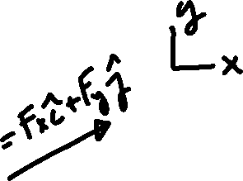

Slide 35
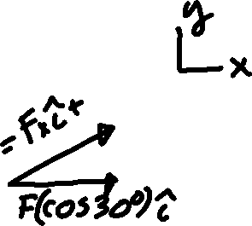


Slide 36
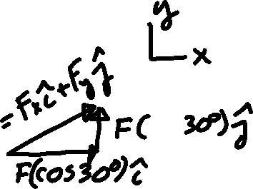


Slide 38


Slide 39



Slide 40




Slide 41


Slide 42
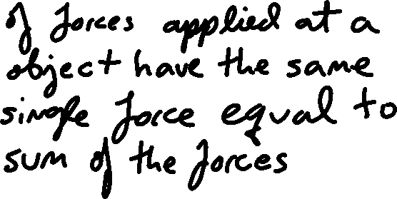
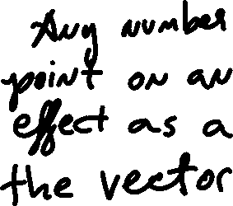

Slide 43










Slide 44
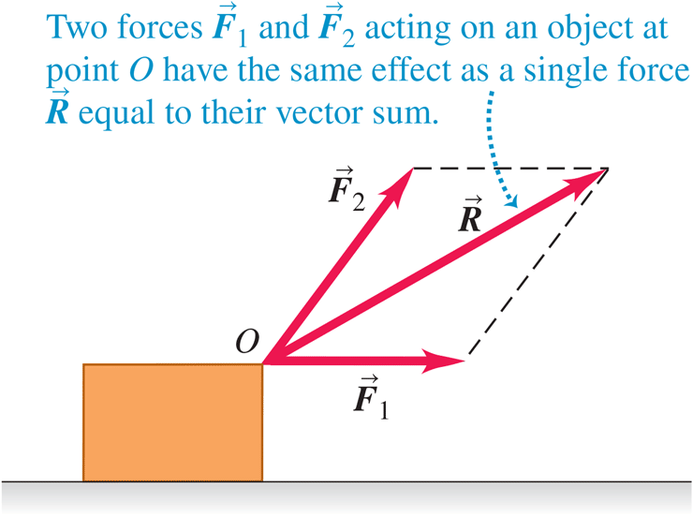


Slide 45
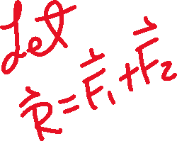

Slide 46


Slide 48




Slide 49





Slide 50




Slide 51




Slide 52





Slide 53
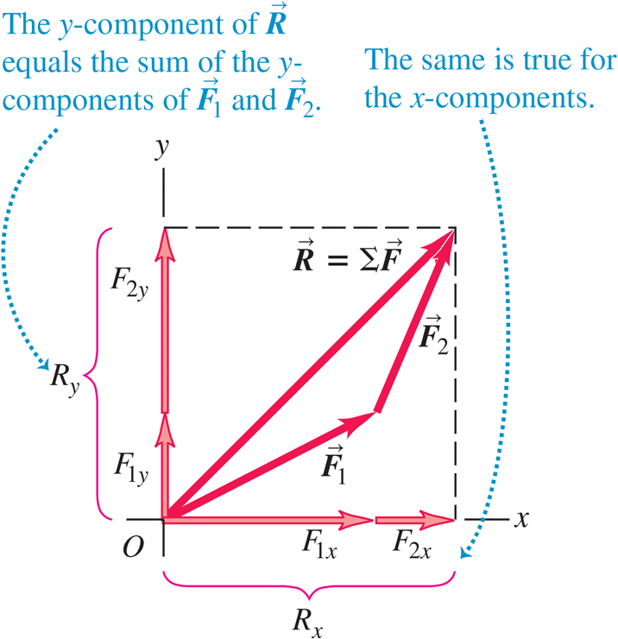



Slide 54



Slide 56


Slide 57


Slide 59









Slide 60
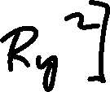

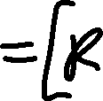



Slide 61
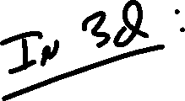

Slide 62
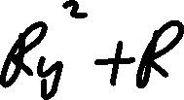




Slide 63
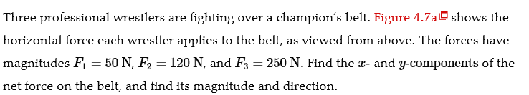

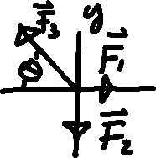


Slide 64




Slide 65





Slide 66




Slide 67






Slide 68





Slide 69





Slide 70



Slide 71


Slide 72





Slide 73



Slide 74


Slide 75





Slide 76
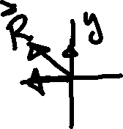

Slide 77
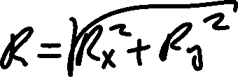

Slide 78


Slide 79



Slide 80




Slide 81


Slide 82





Slide 83


Slide 84



Slide 85




Slide 86


Slide 87





Slide 88



Slide 89


Slide 90




Slide 91




Slide 92




Slide 93



Slide 94






Slide 95



Slide 96



Slide 97
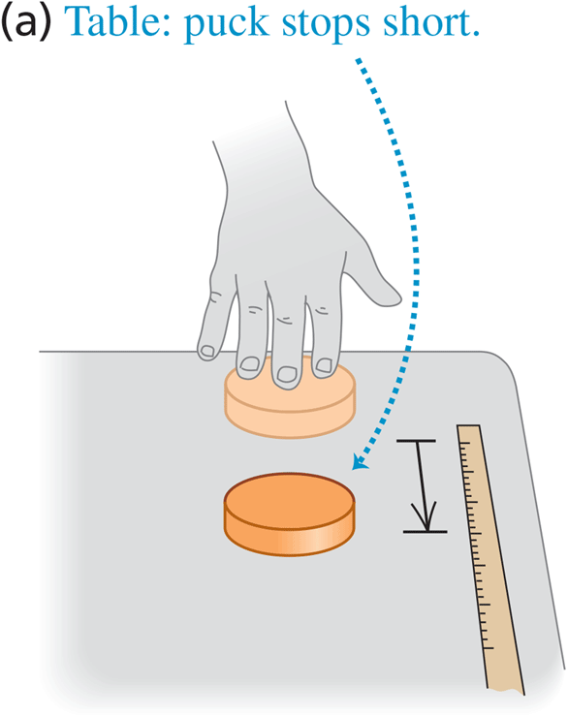

Slide 98
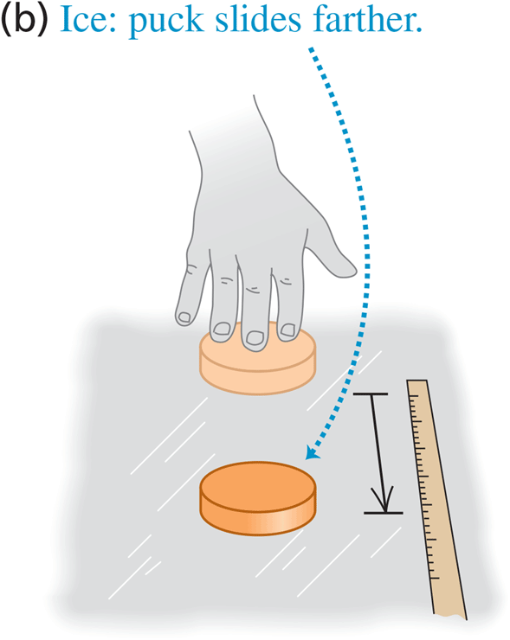

Slide 99
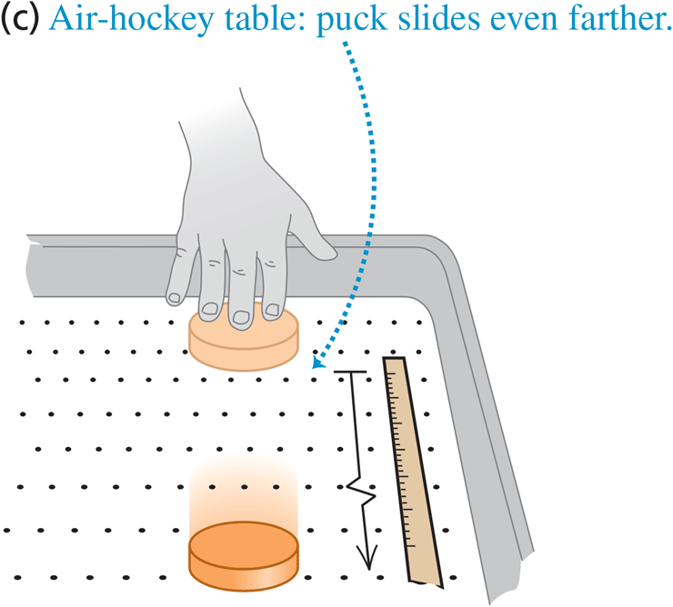

Slide 100



Slide 101


Slide 102




Newton’s first law of motion
An object acted on by no net external force has a constant velocity (which may be zero) and zero acceleration

Slide 103

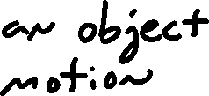


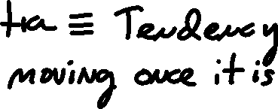
Newton’s first law of motion
An object acted on by no net external force has a constant velocity (which may be zero) and zero acceleration

Slide 104


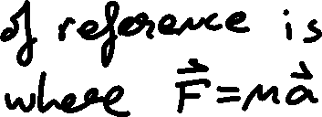





Slide 105


Slide 106










Slide 107
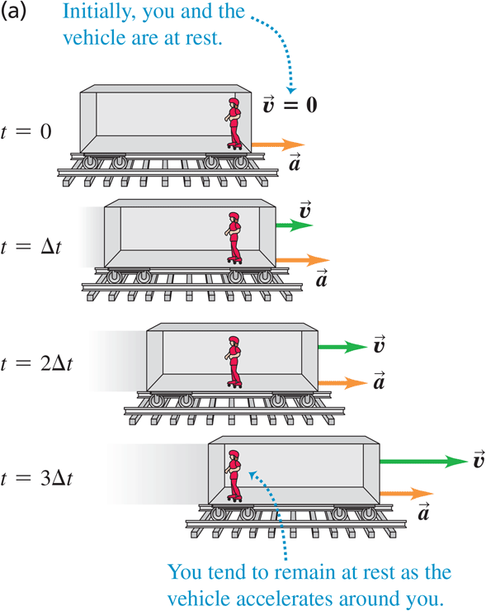

Slide 108


Slide 109
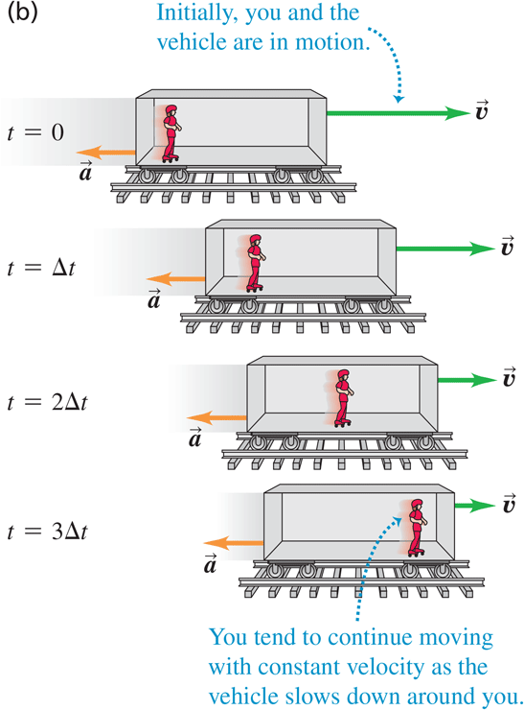

Slide 110
